Slide 1
NIH Research Contracts
Richard L. Hartmann
Chief, DMID Research Contracts Branch A
National Institute of Allergy and Infectious Diseases

Slide 2
NIH Research Contracts
Contracts at the NIH
Difference between Contracts and Grants
Why compete for a contract?
The Contract Award Process

Slide 3
FY12 NIH Spending Grants v/s R&D contracts (in Billions)

Slide 4
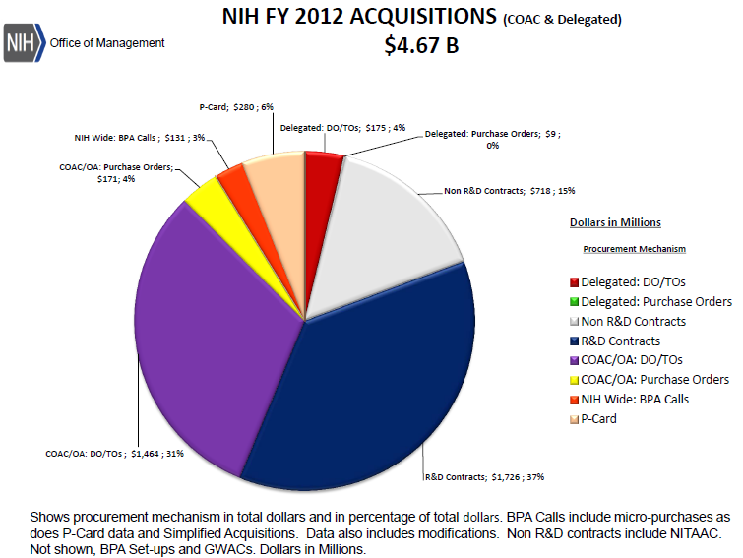
NIH Contract Spending

Slide 5
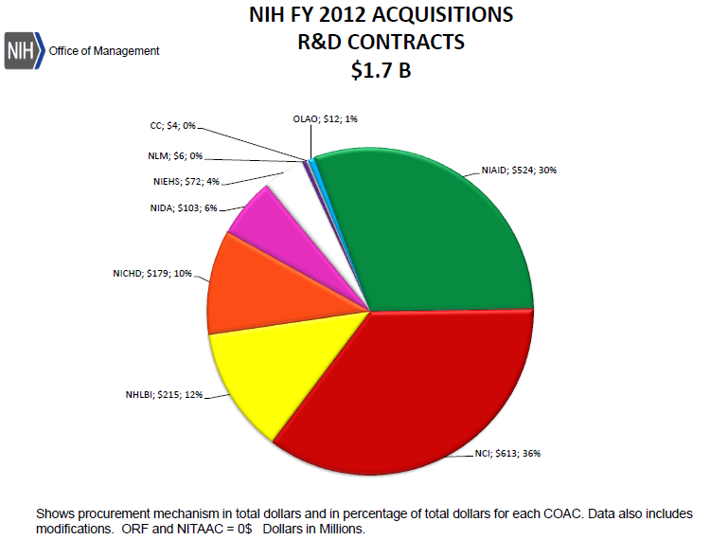
NIH R&D Contracts

Slide 6
Contracts vs. Grants
Grants
Contracts
“Gift” from the Government
Used to support the research for the public good
Peer review of broad criteria
Grants policy
Limited Government oversight and control
Legally binding agreement between the Parties
Used when the primary purpose is to acquire goods or services for the direct use or benefit of the Government.
Award based on stated evaluation factors
Law, regulation and policy
Awards may be protested
Negotiated
More Government oversight and control

Slide 7
Similarities of Grants and Contracts
Required compliance with regulations and policies, such as animal welfare, human subjects protection, fiscal management and administrative compliance
Submission of invoices and technical progress reports
Peer review of concepts and proposals including use of Scientific Review Officers
Team approach to contract management

Slide 8
What is a Contract?
Legal document binding parties
Quid pro Quo
Defined requirement
Specific deliverables
Defined schedule
Cost or price based

Slide 9
Types of Contracts
Fixed Price
Firm or adjustable price for delivery of a product or service
May result from sealed bids or negotiations
Most often for supplies and standard services

Slide 10
Cost-Reimbursement
Contract contains a negotiated estimate
May or may not have a fixed fee
Used when
Uncertainties involved in contract performance do not permit costs to be estimated with sufficient accuracy to use any type of fixed-price contract.
Used when costs cannot be estimated with sufficient accuracy to use any type of fixed-price contract.
Most Research and Development (R&D) contracts are cost-reimbursement

Slide 11
R&D Contracts Procedures
Concepts reviewed by Scientific Advisors
Approved concepts move forward to solicitation
Proposals are solicited
Request For Proposals
Broad Agency Announcements
Proposals are reviewed
Negotiations are conducted
Awards determinations are made
Contracts are awarded

Slide 12
Finding Contract Opportunities
Presolicitation
Concept clearances published on Institute/Center websites
Requests For Information (RFIs)
Sources Sought (SS)
Solicitations
Requests for Proposals (RFPs)
Broad Agency Announcements (BAAs)

Slide 13
Finding Contract Opportunities
NIH Institutes & Centers publish concept clearances on their websites
All Contract Notices
Requests for Information
Sources Sought
Solicitations
Requests for Proposals
Broad Agency Announcements
are published in FedBizOpps - https://www.fbo.gov/

Slide 14
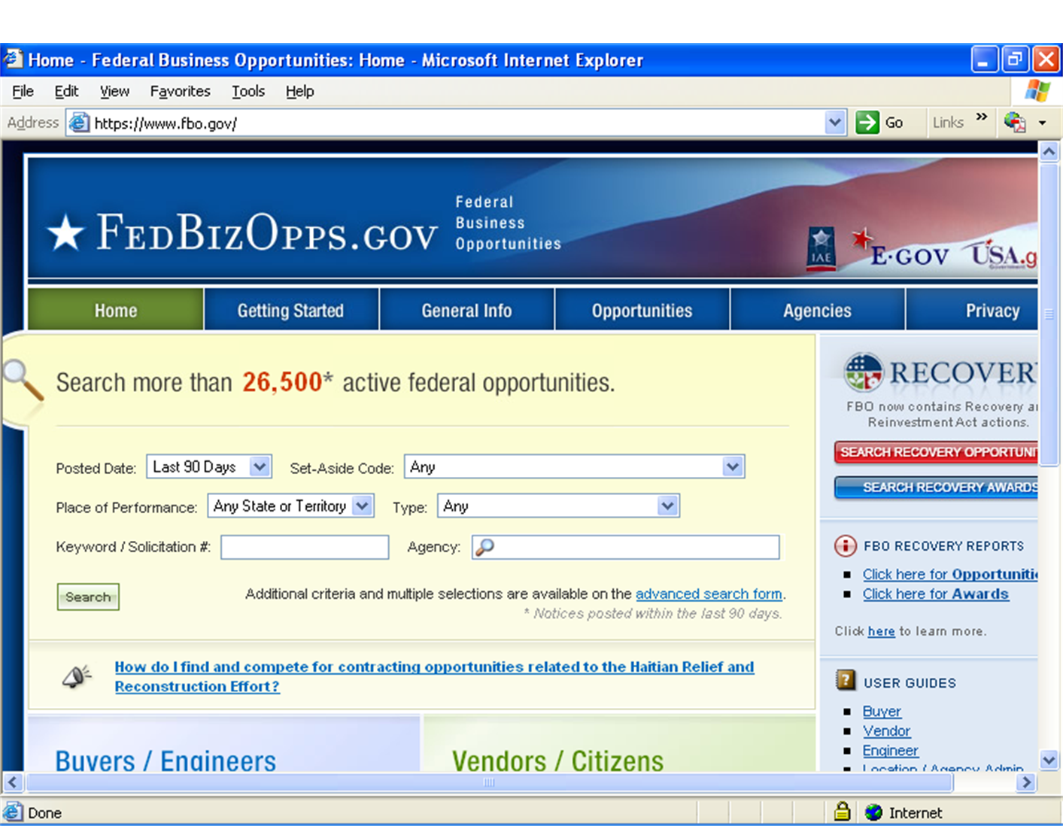

Slide 15
Evaluation of Proposals
Contracts awards from proposals are usually made on the basis of BEST VALUE.
Evaluation Factors for Award
Technical Criteria
Cost
Past Performance
Small Disadvantaged Business Participation
Best Value considers all factors based on the relative importance

Slide 16
Technical Evaluations
Technical evaluation criteria are reviewed by independent Peer Review
Sample technical evaluation criteria
Technical Approach
Personnel
Facilities
Technical criteria are often weighted
Reviewers determine technical acceptability

Slide 17
Evaluation of Cost and Other Factors
NIH staff review the other factors
Cost reasonableness of the cost proposal
Examination of past performance
Review of Small Disadvantaged Business participation

Slide 18
Competitive Range and Negotiations
Establish a rating of all proposals based on all evaluation factors
Establish a competitive range of the most highly rated proposals
Negotiate with the offerors of the most highly rated proposals
Request Final Proposal Revisions (FPRs)

Slide 19
Award Selection
After negotiations conclude, the Contracting Officer evaluates the Final Revised Proposals against the Evaluation Factors described in the solicitation to determine which vendor is awarded a contract.

Slide 20
Should You Submit a Proposal?
READ THE SOLICTATION!
The solicitation should contain all the information needed to prepare a proposal.
Statement of Work (SOW) or Statement of Objectives (SOO)
Instructions to offerors
Type of contract
Set- Aside restrictions
How and where to submit the proposal
Evaluation factors for award

Slide 21
Things to Consider in a Proposal
Can you convince reviewers of your technical abilities?
Demonstrate your understanding of the requirement.
Demonstrate the soundness of your technical approach.
Show the strengths of your technical team.
Present facilities
Can my proposal be cost competitive?

Slide 22
References
NIH Office of Acquisition and Logistics Management (OALM) http://oalm.od.nih.gov/
FedBizOpps https://www.fbo.gov/
Federal Acquisition Regulations (FAR) https://www.acquisition.gov/far/
Department of Health and Human Services Acquisition Policies and Guidance http://www.hhs.gov/asfr/ogapa/acquisition/policies/index.html

Slide 23
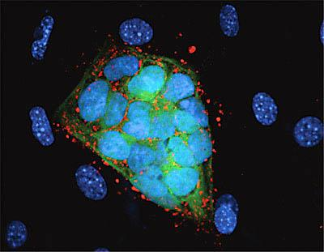
WE VALUE YOUR INPUT!
2014 NIH REGIONAL SEMINAR
Session Evaluations: http://surveymonkey.com/s/nihsessions Overall Evaluations: http://surveymonkey.com/s/nihoverall
NIH…
Turning Discovery Into Health

